Slide 1



L16 – Uncorrelated Track Processing
By: Kyle Galang, Aurela Broqi, Ruben Dennis, Aaron Nogues, Ezra Stone
Notes:
- FILL IN / REMOVE ALL NOTES

Slide 2
Table of Contents
Full-stack Technology in OpenEvolve
UI Logic
UI Data Changes
UI Time-Series Updates
Linear Regression
Questions

Slide 3
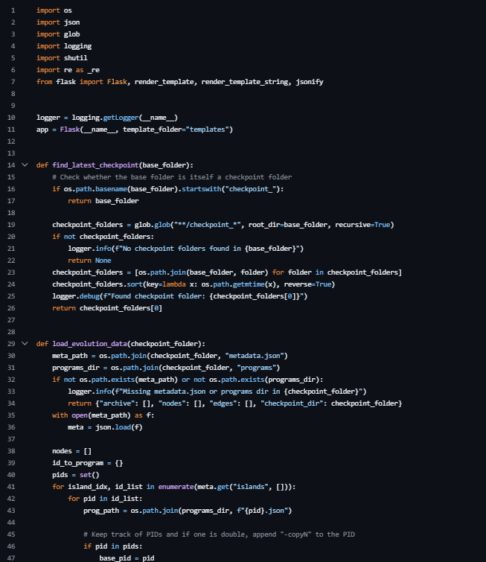
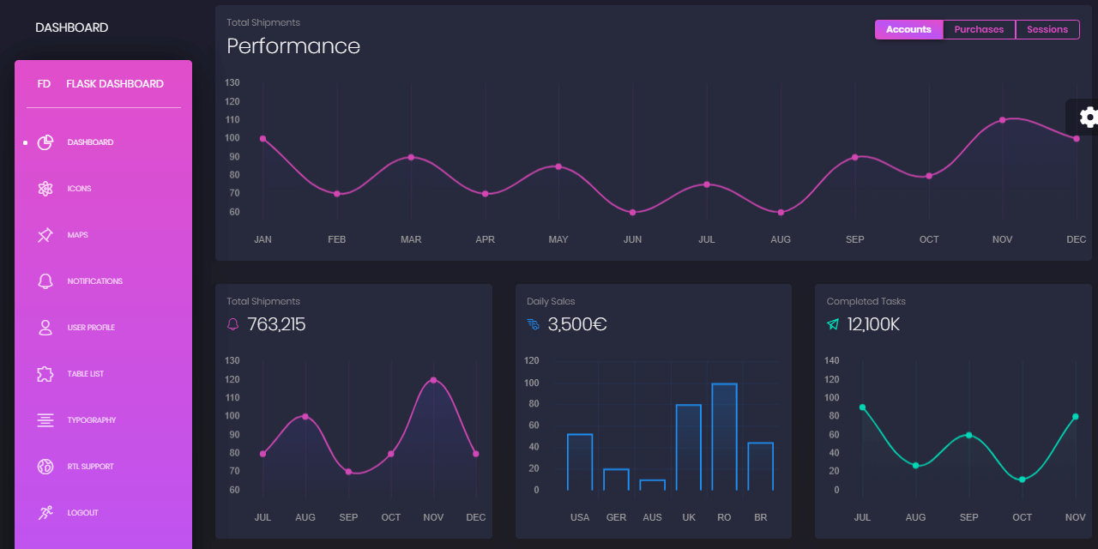
Full-stack Technology in OpenEvolve
Visualizer.py
OpenEvolve tech stack: JSON Python + Flask HTML/CSS/JS
Environment: Real-time API scans per checkpoint All local

Slide 4
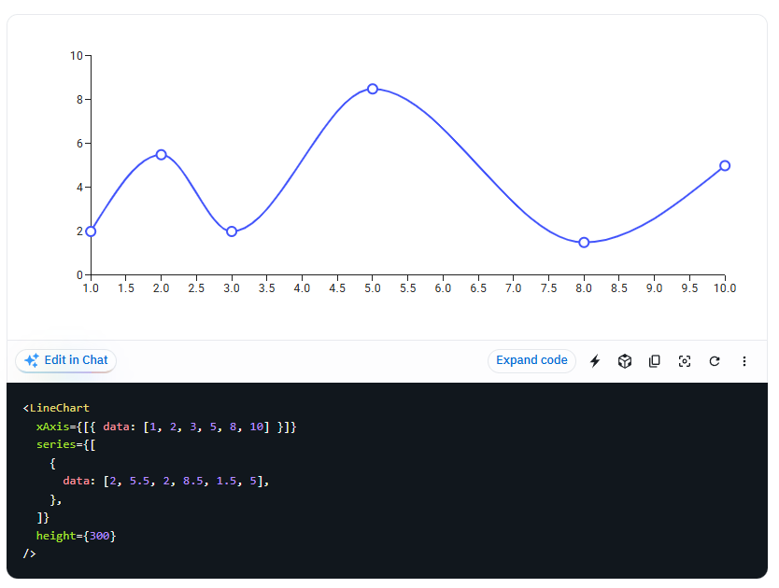
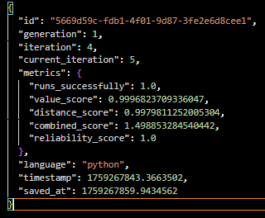
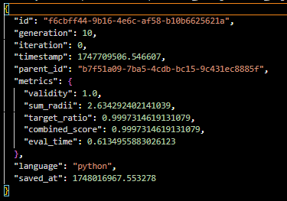
User Interface: Logic
UI Specifications asked for real time updates to show the efficiency of each checkpoint compared to the original evaluation of program. - Flask checks the file system everytime the browser calls it and reads JSON. - The problem is, the logic behind the metric time-series is it heavily relies on the evaluation logic.
Function_minimization
Circle_Packing

Slide 5
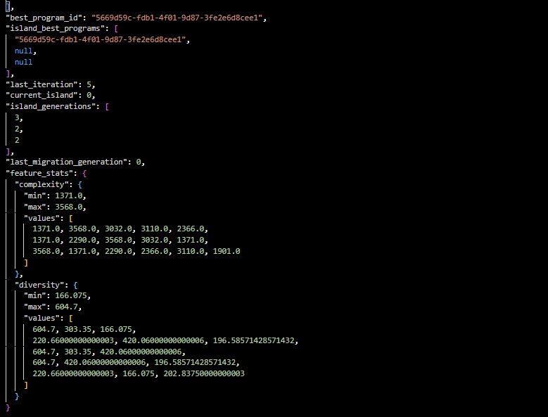
User Interface: Data Changes
UI updates get passed along through the checkpoint metadata JSON source file.
Iteration 5:

Slide 6
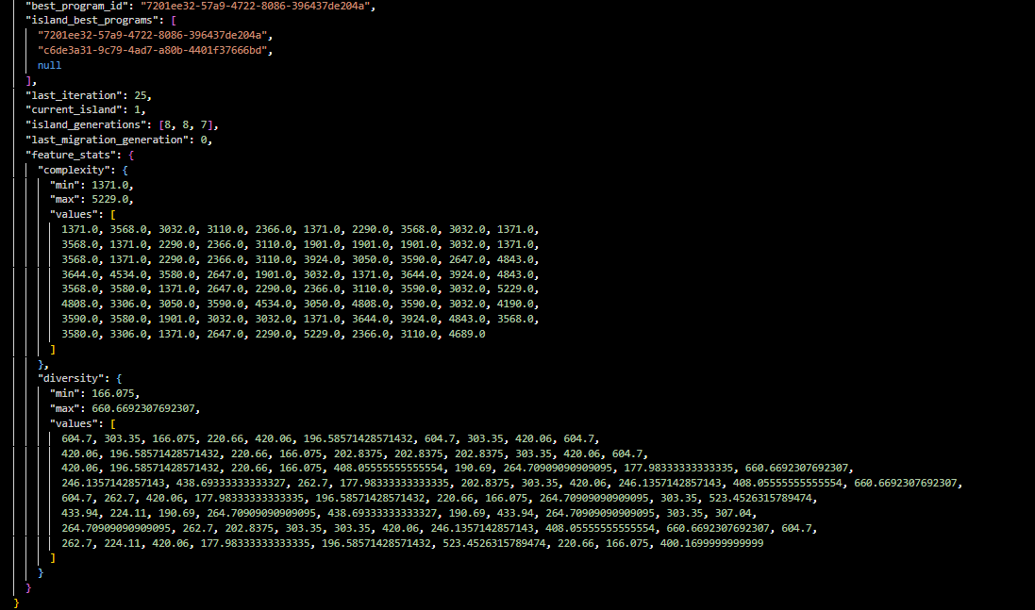
User Interface: Data Changes
UI updates get passed along through the checkpoint metadata JSON source file.
Iteration 25:

Slide 7
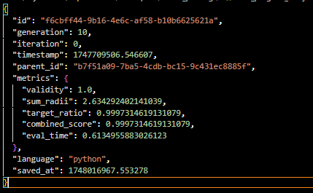
User Interface: Time-Series Updates
Diversity and Complexity is provided per iteration, so we will just need to create a time series line chart to show the efficiency changes per iterations.
Some cases to look at are the feature_stats and the combined_score parametrics provided in the metadata.json.
value_score: how close we got to the minima in function_minimization. (1.0 best possible result)
distance_score: how far solution is in coordinate space from true optimum. (1.0 exactly optimum)
combined_score: overall fitness combining value and distance. (combined_score=value_score+distance_score)
reliability_score: consistency and robustness (1.0 all inputs tested are stable no failed states)
This best_program_info.json changes per algorithm.

Slide 8
User Interface: Time-Series Updates

Slide 9
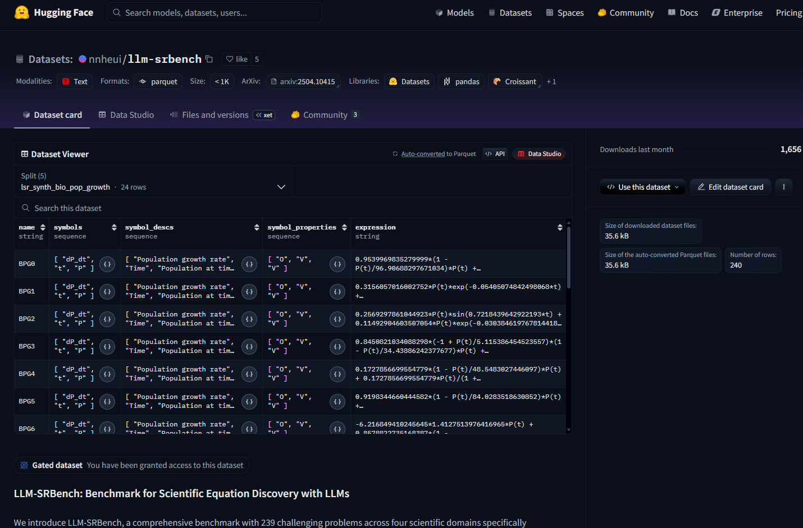
Linear Regression
There IS a symbolic regression algorithm in the examples of the github. The implementation of the algorithm is based on the data provided by this data set on the hugging face platform. (nnheui/llm-srbench · Datasets at Hugging Face)
For us to use a regression algorithm it is integral to have the data prior to making the base function and evaluator script themselves.

Slide 10
Questions
Open discussions Blockers:
Lacking behind research and documentation.
For the regression algorithm to be truly implemented, the data is required.

